Slide 1
NINJACART CASESTUDY
By KHUSHI ATREY
RA2111003010610
ka5052@srmist.edu.in

Slide 2
INTRODUCTION
Ninjacart is a top Agri-tech platform in India that connects farmers directly with retailers, grocers, and businesses, changing the way fresh produce is delivered. Since its founding in 2015, it has streamlined the agricultural supply chain by reducing the number of middlemen, which often leads to delays, waste, and inconsistent quality.
Currently, Ninjacart partners with over 500,000 farmers and supplies fresh produce to more than 100,000 retailers across the country. The platform offers services such as product discovery, trade credit, and delivery, ensuring better prices for farmers and fresh, high-quality fruits and vegetables for retailers. Ninjacart uses innovative technology, including fintech solutions, computer vision for quality control, and cold-chain logistics, which helps to minimize waste and improve delivery times.
This case study will focus on how Ninjacart can expand its distribution network and become the go-to partner for cherry brands in India, analyzing market potential, supermarket buying behavior, and recommending strategies to boost cherry sales by leveraging Ninjacart’s strengths.

Slide 3
Overview of the Cherry Fruit Market in India
Cherries are seen as a premium fruit in India, and their consumption is slowly rising as people become more health-conscious and interested in exotic fruits. However, they are still considered a niche product, mainly enjoyed in urban areas where there is a greater demand for high-quality and imported fruits.
Current Scenario India's domestic production of cherries is limited, primarily coming from northern regions like Jammu and Kashmir and Himachal Pradesh. Unfortunately, the supply is not sufficient to meet the increasing demand, leading to many cherries being imported from countries like the USA, Turkey, and Chile.

Slide 4
Top 5 Cherry-Consuming States in India
Delhi NCR: Due to the higher income levels and preference for premium fruits.
Maharashtra (Mumbai, Pune): Urban areas with high demand for imported fruits.
Karnataka (Bangalore): With a rising demand for health and wellness products.
Tamil Nadu (Chennai): Strong demand in supermarkets and for special occasions.
West Bengal (Kolkata): Interest in exotic fruits is growing, especially in urban areas.
These regions have larger urban populations with more disposable income, where cherries are consumed regularly.
Best Season for Cherries in India
The best season for fresh cherries in India is between May and July, when the domestic harvest from Jammu and Kashmir and Himachal Pradesh is available. However, due to imports, cherries can now be found in the market throughout the year, though they are more expensive during the off-season.
This growing demand and the fruit’s premium status make cherries an attractive segment for distribution, especially in metropolitan areas.

Slide 5
Factors Contributing to Growth in Cherry Consumption:
Health Awareness: More people are becoming aware of health benefits and are choosing fruits like cherries for their high levels of antioxidants.
Rising Incomes: As people earn more, especially in cities, they are more willing to spend on premium fruits like cherries.
Increased Availability: Thanks to better cold-chain logistics and imports, cherries are now available throughout the year, making them easier to find.
Changing Lifestyles: Urban living and exposure to global food trends have made consumers more willing to try exotic fruits like cherries.

Slide 6
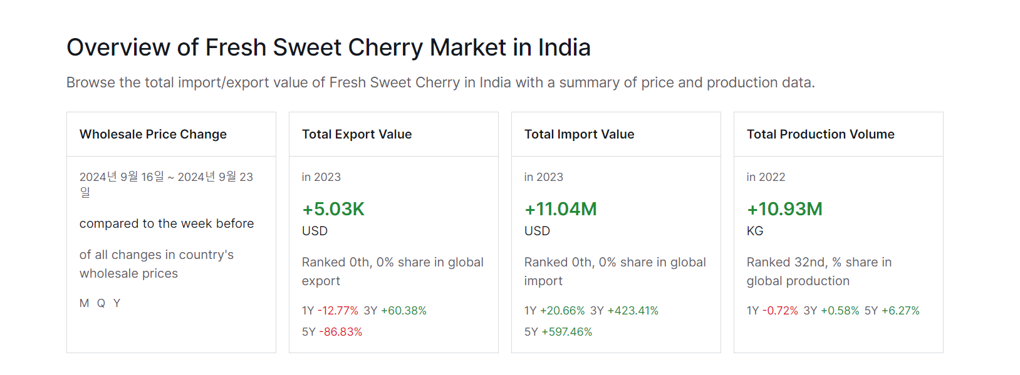
Estimated Annual Consumption based on 2024:
Current Consumption: 6000-6500 tons (assumption based on limited domestic production and import data).
Annual Growth Rate: 8-10% (assumption based on similar fruit trends and economic growth).
Monthly Consumption: Divide annual consumption by 12 months.
Monthly Cherry Consumption:
6,000 tons ÷ 12 = 500 tons per month (low estimate)
6,500 tons ÷ 12 = 541.6 tons per month (high estimate)

Slide 7
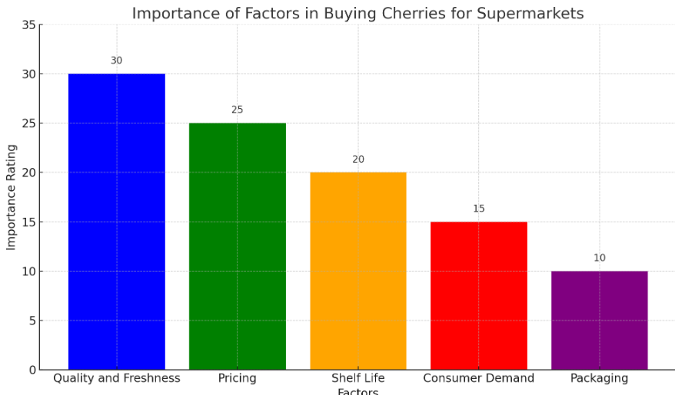
After surveying 8-10 people and visiting 5-6 supermarket based analysis :
Several key factors which supermarket owners consider while buying cherries:
Quality and Freshness: Supermarkets check for quality issues, such as splits, soft spots, and overall freshness, to ensure they offer the best product to customers​
Pricing: They consider the cost of cherries, which can vary based on season, supply, and whether the cherries are organic. High prices can deter purchases​
Shelf Life: Given cherries' short shelf life, stores assess how long the cherries will remain sellable and minimize spoilage​
Consumer Demand: Supermarkets gauge customer interest in cherries, including preferences for fresh cherries versus processed forms like jams​
Packaging and Presentation: The way cherries are packaged can affect their appeal and price, with bulk buying often being more cost-effective​

Slide 8
Based on visits to multiple supermarkets and discussions with shop vendors, pastry chef and managers, here is the feedback they provided:
Vendors usually avoid buying cherries because they are expensive.
Cherries spoil quickly, within 1 to 3 days.
Storing cherries is costly.
Many customers are not aware of cherries and their benefits.
People often consume cherry products, like jams, instead of fresh cherries.
Cherries are not well-known in areas with low urban populations.
https://drive.google.com/file/d/1DOMP-Upy2_A0C5zjcNHJ3cJg0AIN3bCl/view?usp=drive_link
Video of survey, the person spoke in tamil as preferred comfortable language.
Location: Dmart supermarket,chengalpattu

Slide 9
Based on 2024 data and the growth of supermarkets in Chennai, it is estimated that 330 to 400 supermarkets in Chennai could potentially buy and stock cherry fruit.
Here’s why:
With these factors in mind, the estimated number of supermarkets that will buy cherries in Chennai by 2024 is between 330 and 400 supermarkets, primarily targeting upper-middle-class customers.
Supermarket Growth: By 2024, Chennai is expected to have around 1,100 to 1,150 supermarkets, with big chains like Reliance Fresh and Nilgiris expanding.
Premium Fruit Demand: Cherries are in high demand at premium supermarkets catering to affluent customers in Chennai, which has one of the highest fruit consumption rates​.
Cold-Chain Logistics: Only premium supermarkets with cold storage can stock cherries, ensuring their freshness​

Slide 10
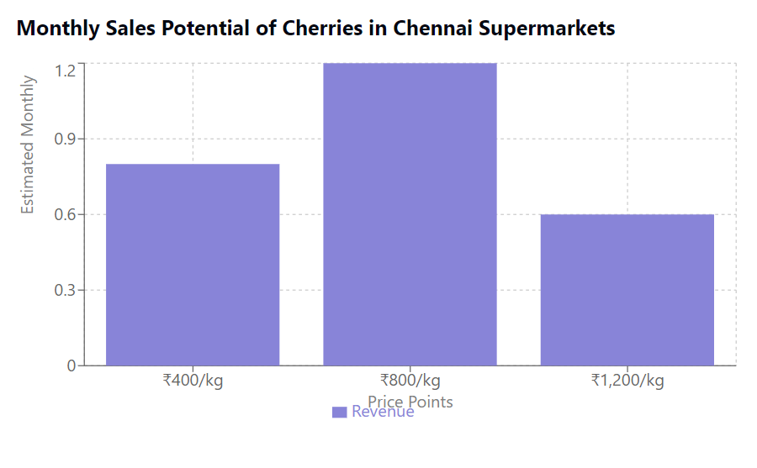
To estimate the monthly sales potential of cherries in Chennai via supermarkets in 2024, let’s break it down:
Current Cherry Prices: The retail price of cherries in India ranges from ₹437.77 to ₹1,273.50 per kg​(Selina Wamucii's Cherry Price Insights​(Selina Wamucii).
Chennai’s Supermarkets: Based on around 330 to 400 supermarkets likely selling cherries, we can assume each supermarket could sell approximately 200 kg per month.
Sales Calculation:
At ₹437/kg: 330 supermarkets × 200 kg × ₹437 = ₹2.88 crore.
At ₹1,273/kg: 400 supermarkets × 200 kg × ₹1,273 = ₹10.18 crore.
Thus, the monthly sales potential is between ₹2.88 crore and ₹10.18 crore.

Slide 11
Ninjacart's exsiting offerings:
Direct Farmer-to-Retailer Model: Ninjacart connects farmers directly with retailers, reducing reliance on middlemen and ensuring better prices for farmers and fresh produce for retailers​.
Marketplace Expansion: They have launched a marketplace that includes not only farmers but also traders and wholesalers, allowing for improved price transparency and access to more buyers​
Financial Services: Collaborating with banks like IDFC First, Ninjacart provides financial solutions and credit to support farmers and traders in managing their operations​
Product Diversification: While continuing to focus on fresh produce, Ninjacart is expanding into non-fresh grocery items, such as rice and pulses, aiming for a revenue target of ₹2,500 crore for 2024

Slide 12
Additional solutions Ninjacart can provide to boost cherry sales in supermarkets
Recipe Cards: Provide simple recipe cards near the cherry display. Ideas for smoothies, desserts, or salads can inspire customers to try cherries in new ways.
Health Benefits Signage: Highlight the health benefits of cherries, like being rich in antioxidants. This can attract health-conscious shoppers.
Collaborations with Local Chefs: Invite chefs to demonstrate cherry recipes in the supermarket. Live cooking demonstrations can engage shoppers and boost sales.
Seasonal Promotions: Tie cherry promotions to holidays or seasonal events, such as summer picnics or holiday baking, to create a sense of urgency.
Sustainability Focus: Highlight the eco-friendly practices used in growing and sourcing cherries. Many consumers today care about the environment and would love to support a brand that does too.
Eye-Catching Packaging: Use colorful, clear packaging that showcases the cherries. Add QR codes for customers to scan and learn more about where their cherries come from and their health benefits.
Engaging Content: Produce fun videos and posts about the health benefits of cherries and how to enjoy them. Share this content widely on social media to attract attention and educate customers.

Slide 13
Final solution and approach:
Cold Chain Logistics: Invest in better cold storage and transportation systems to keep cherries fresh from the farm to supermarkets. This reduces spoilage and ensures high-quality cherries for consumers.
Market Insights: Use data analytics to track demand trends in Chennai, ensuring supermarkets are stocked with the right quantity of cherries during peak buying times, reducing waste and increasing sales.
Promotional Support: Run in-store promotions, such as tasting events and discounts, and collaborate with chefs to create engaging recipes, making cherries more attractive to shoppers.

Slide 14
Summary of the Case Study:
Ninjacart is a leading Agri-tech platform in India that connects farmers directly with retailers, cutting out middlemen to improve efficiency and reduce waste in the fresh produce supply chain. Currently, Ninjacart works with over 500,000 farmers and supplies produce to more than 100,000 retailers. Their use of technology, such as cold-chain logistics, data analytics, and fintech solutions, ensures fresh produce is delivered quickly and at fair prices.
This case study focuses on exploring how Ninjacart can become the go-to distribution partner for cherry fruit brands in India. It examines the market potential for cherries, how supermarkets in Chennai purchase cherries, and proposes strategic solutions, including better cold-chain logistics, data-driven market insights, and promotional support to boost cherry sales.
By leveraging its strengths in supply chain management and technology, Ninjacart can help increase cherry sales in supermarkets and expand its influence in the premium fruit market.

